Slide 1
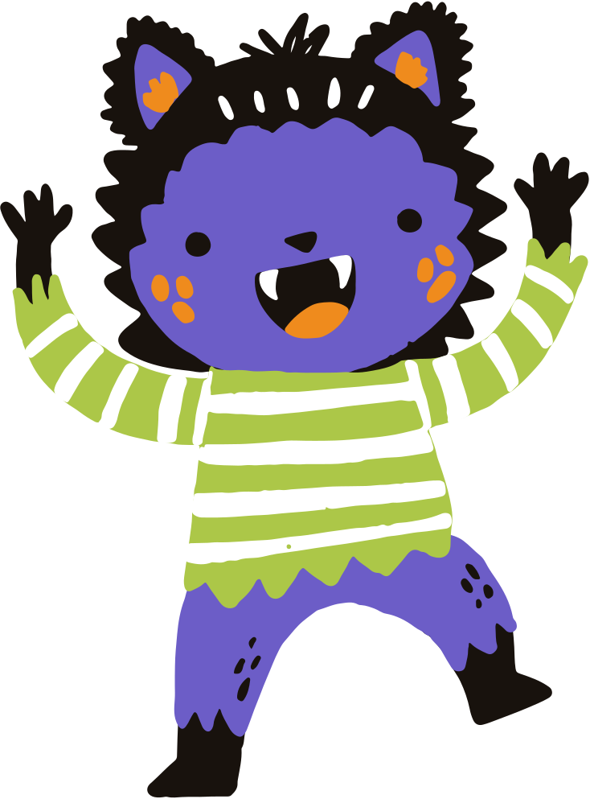

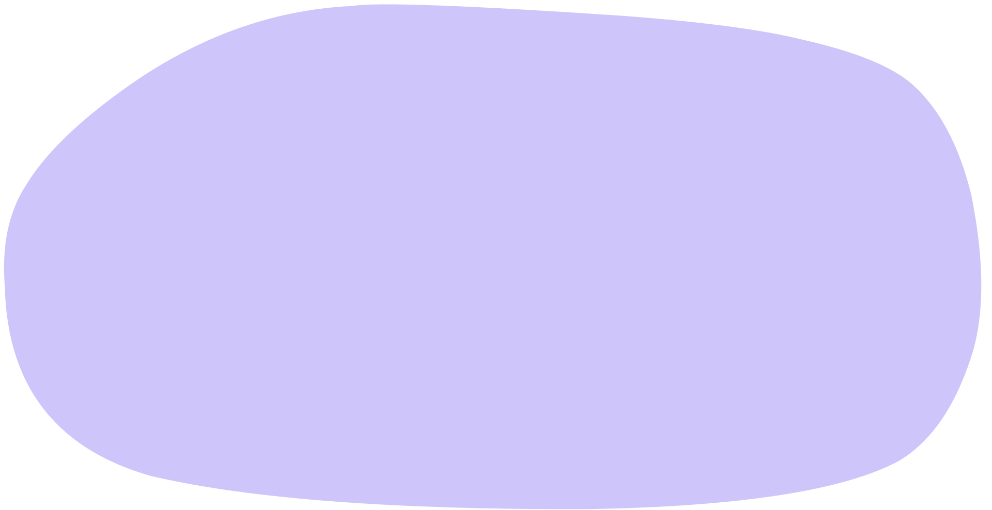

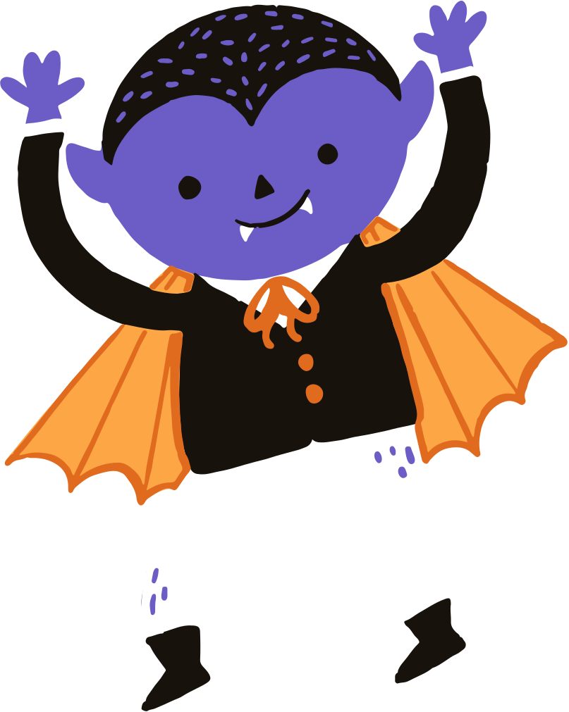
Cerebral Beach Hacks
Twelve Labs Challenge for Media Entertainment Track
TEAM GHOOL

Slide 2





Table of Contents
01
The System’s Capabilities
04
Challenges faced
02
The Workflow
05
Challenges Overcome
Twelve Lab’s Models Improved Production efficiency
03

Slide 3
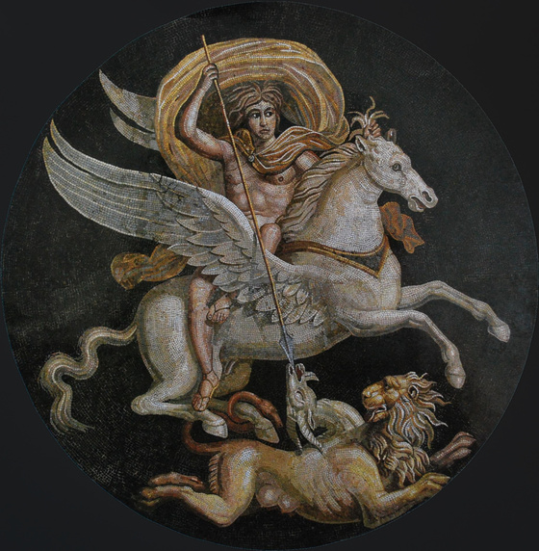
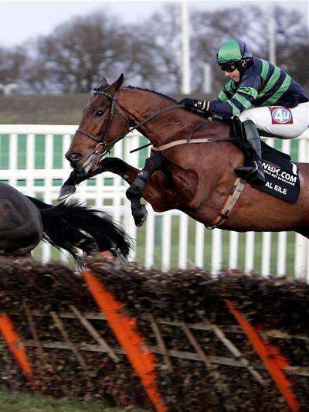
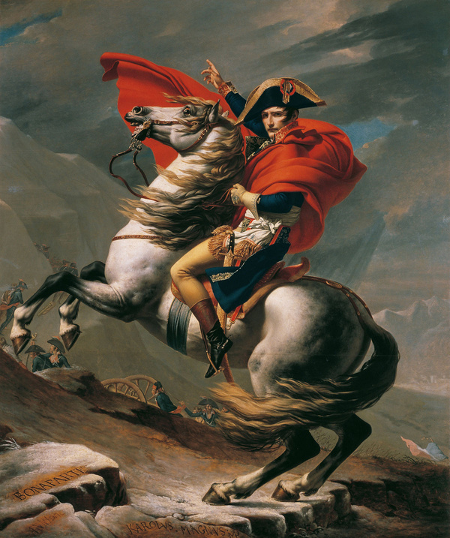
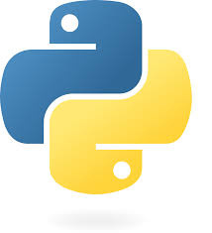
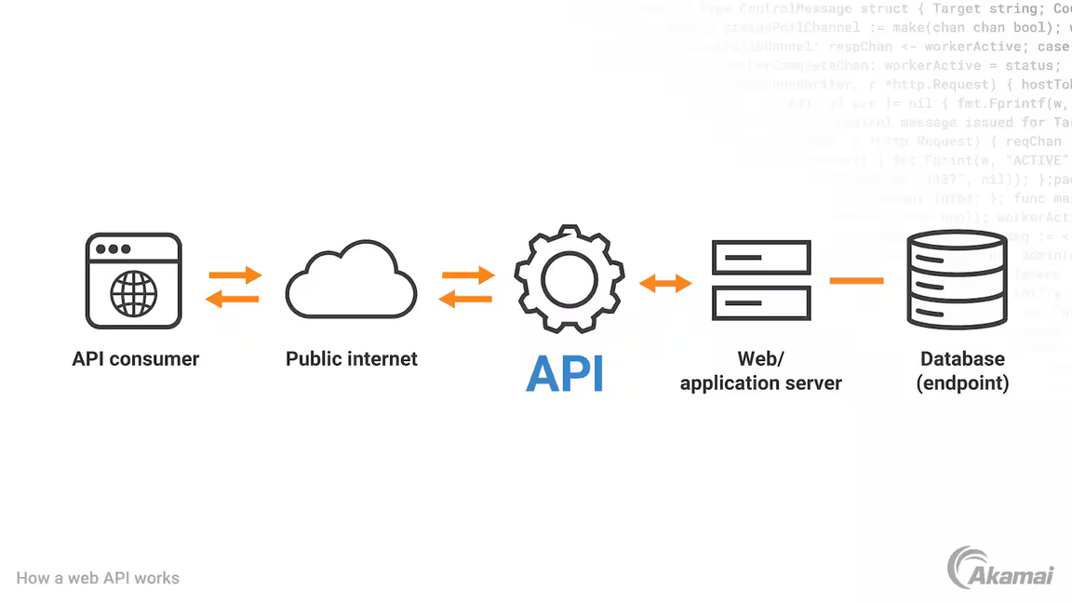
The system
Python Scripting based on:
Twelve Labs of Marengo & Pegasus Engine (SDK)
MoviePy (FFmpeg)

Slide 4
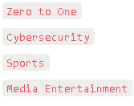
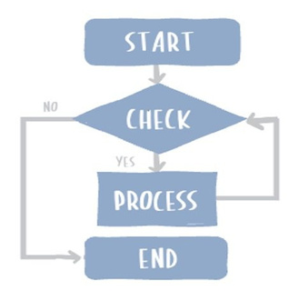
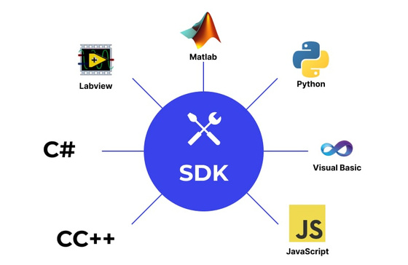
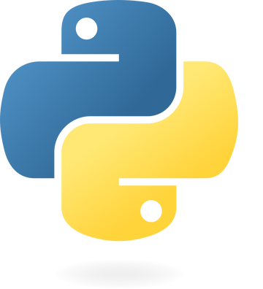

The WorkFlow
DECIDING A TRACK
WRITE PSEUDOCODE
TESTING THE SDK
IMPLEMENT THE SCRIPT
figuring out how the engine works
writing code and testing
horror track
flowchart
OBTAINING ROUGH DRAFT
FINALIZING THE FINISHING TOUCH
using the tools to quickly obtain need
using premier to edit the rough draft

Slide 5
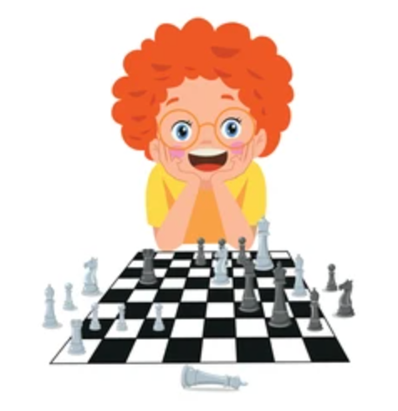


Twelve LABS
Jockey
Marengo
Pegasus

Slide 6



challenges
LIMITED EDITING SKILL
LIMITED CREATIVE SKILL
LIMITED CODING KNOWLEDGE
LIMITED SLEEP

Slide 7





Solutions
WE SPEND MORE TIME
WE GO FOR WALKS
WE ASK FOR HELP (KINDO.AI)
REDBULL&COFFEE

Slide 8

After Using TwelveLabs extensively, we realized THAT it is pretty great
What would be even more great though is doing an internship there
if you have open positions 👉👈

